Slide 1
Intro to Neural Networks
Tim Book
Notes:
1 MINUTE
TALKING POINTS
Make sure people are in the right room
If people arrive early, check they have installed Anaconda
TEACHING TIPS
This is a suggestion for the instructor on something to do before, during or after presenting this slide.
This is another suggestion.

Slide 2
First: A Brief History of Neural Networks
While they’ve recently gained popularity, they are not new. Research on what we now call deep learning can be traced all the way back to the 1940s. It’s gone through several names:
Cybernetics (1940s - 1960s)
Connectionism (1980s - 1990s)
Deep learning / artificial neural networks (term first used in 2006)

Slide 3
So… why are we just hearing about them now?
The reason neural networks didn’t gain traction until recently is because all “good” implementations require A LOT of computational power. Even basic neural nets require a level of computing unavailable on 1960s “supercomputers”.
Small neural nets were feasible back then, they just didn’t perform as well as more classical approaches (linear regression, logistic regression, namely).

Slide 4
What changed?
Three things led to the modern feasibility of neural networks that we enjoy today:
Increased computing ability. The fact that you can train a multi-layer neural net on your personal laptop is incredible.
Increased algorithmic efficiency. Smarter math leads to fewer computations needing to be done.
Increased availability of data. Neural nets need a lot of data to work properly. There is no shortage of data these days.

Slide 5
Why the name?
Initially, neural nets were inspired by the way our brains’ neurons work.
This inspiration didn’t last long.
And then we found out that’s not how brains work.
The name stuck anyway.

Slide 6
MYTH
FACT
Neural networks mimic the way our brains’ neurons process information.
Neural networks are statistical models. Sometimes, researchers will incorporate loose inspirations from neural biology. Sometimes, they lead to improvements.

Slide 7
Uses for Neural Networks
Neural nets have found numerous uses. It’s harder to find places where you can’t use a neural net. (Note there are many times you shouldn’t). What will be most interesting to us, is its flexibility to work with many kinds of data:

Slide 8
Traditional Panel Data
Of course, neural nets can handle the usual panel-style data we’ve been working with up until now. Neural nets can be used for both regression and classification.
Working with the “usual” kind of data is done with feed-forward neural networks (sometimes written FNNs), which is what we’ll focus on today. You’ll learn to implement them in Keras this afternoon.

Slide 9
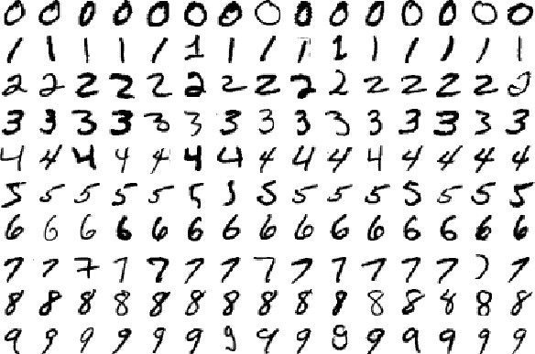
Image Data
Convolutional Neural Networks (CNNs) are a variety of neural networks especially equipped to work with image data.

Slide 10
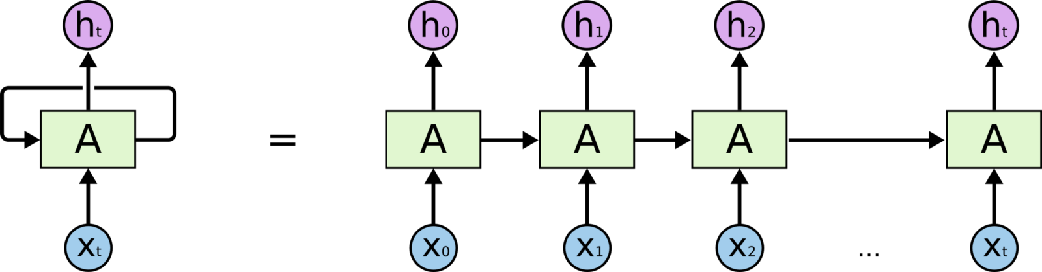
Sequence Data
Recurrent Neural Networks (RNNs) are a variety of neural networks that specialize in working with sequence data, such as time series or natural language data.

Slide 11
Recap: Logistic Regression
Let’s suppose I have some x-variables, and I want to use them to predict a binary 0/1 y-variable using logistic regression.
Let’s rewrite:
Let’s refer to the βs as “weights” with a “bias” term instead:

Slide 12
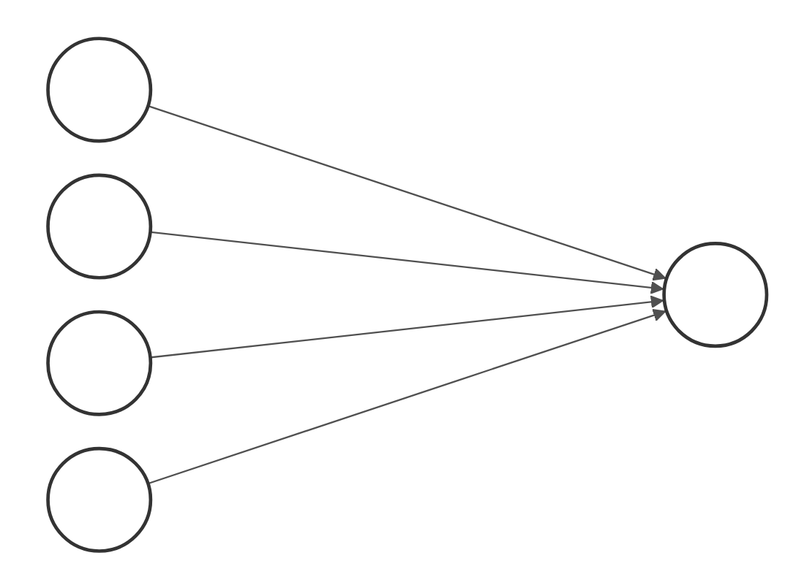
Let’s draw this as a graph!
1
b
x₁
w₁
w₂
z
σ(z) = prediction
x₂
w₃
x₃

Slide 13
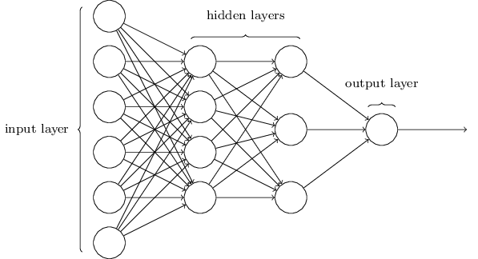
What if we kept stacking logistic regressions?
Output of one gets transformed and then passed as input to another:
???
Prediction!
Data goes here!
Transformation!
(here: inverse logit)
Very many weights

Slide 14
What if we kept stacking logistic regressions?
Output of one gets transformed and then passed as input to another:
More tiny logistic regressions, each with their output transformed and passed into the next layer.
Prediction!
Data goes here!
Transformation!
(here: inverse logit)
Very many weights

Slide 15
Why did we do this?
Curvy part
Linear part
The linear parts allow our data to impact our result.
The the transformation (curvy) part allows us to learn more complex, non-linear relationships between x and y.
Multiple layers allow us to learn even more wiggly and complex relationships within our data.
Let’s play!

Slide 16
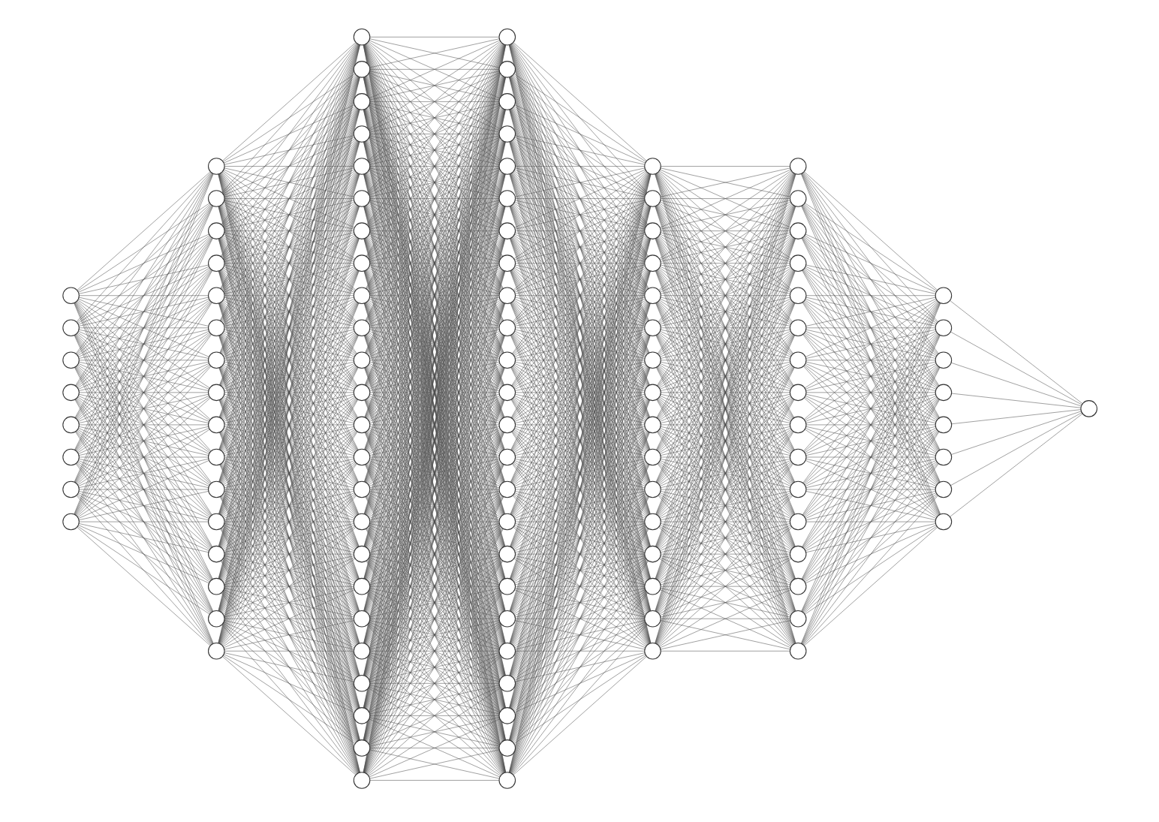

“Deep Learning”
The term “deep learning” comes from the fact that you often have many hidden layers, making your graph very deep. Be careful though: neural nets are prone to overfitting!

Slide 17
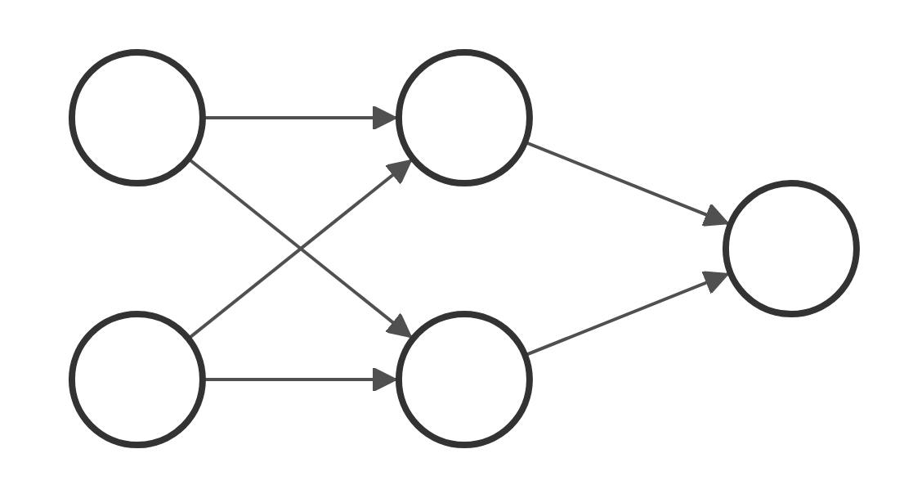
Slack Quiz: What is my output here?
(Assume no transformations)
3
2
2
6
3
2
-1
5

Slide 18
Slack Quiz: What is my output here?
(Assume no transformations)
3*2 + (-1)*6=
3
2
0
2
0*2 + 4*2=
6
8
3
2
-1
4
5
3*3 + (-1)*5 =

Slide 19
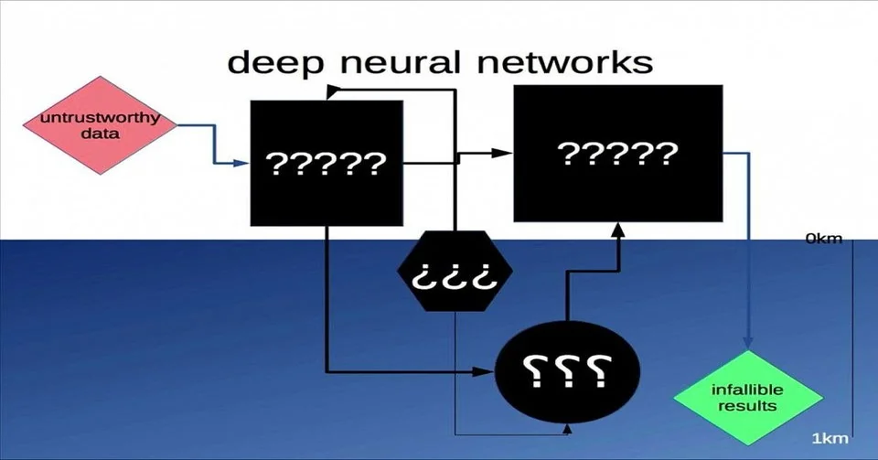
What have we done?!

Slide 20
These Neural Networks are “Feed Forward”
The neural networks we’ve seen so far are:
Feed forward: Calculations are passed down the network in one direction.
Fully connected: Each node is connected to every node in the previous layer, and every node in the next layer.

Slide 21
Knobs & Levers
When constructing a neural net, you have many choices to make, such as:
Number of hidden layers
Number of nodes in each hidden layer
Choice of activation functions
Loss function
We’ll discuss what each of these mean and how to choose them.

Slide 22
Number of hidden nodes and layers
These control the complexity of your model. Too much of either will cause you to overfit. You’ll often need to regularize (more on this later this week).
Unfortunately, there is no hard rule on how you should construct these. They will involve a painful amount of trial and error, as your situation will always be unique.
Here is some common advice, though:

Slide 23
Hidden Layer Wisdom (Feed Forward Only!)
More hidden layers = More overall complexity of relationship learned
More hidden nodes = More relationships learned (that will eventually be aggregated into prediction)
In FNNs (fully connected/feed forward neural nets), there is very rarely reason to have more than two hidden layers. One is usually sufficient.
A general rule of thumb:
The number of hidden nodes should be somewhere between the number of nodes in the input and output layers.*
*Yes, there can be multiple nodes in the output layer, we will soon see.

Slide 24
Activation Functions
An activation function is a transformation function applied to the output of a layer. In our special case of a logistic regression, the activation function was the inverse logit. In deep learning literature, this actually called the sigmoid activation (hence why we denoted it σ).
Here are some activation function flash cards:

Slide 25
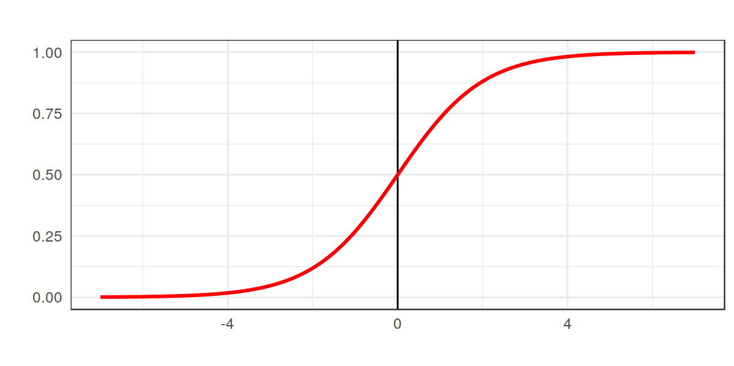
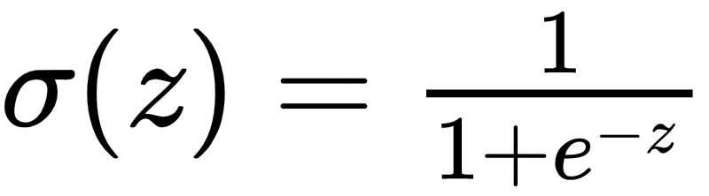
Sigmoid
Since the sigmoid function ranges from 0 to 1, it is often used as the output activation for binary classification models.
It used to be used as hidden layer activations, too, but has since been abandoned in favor of ReLU.

Slide 26
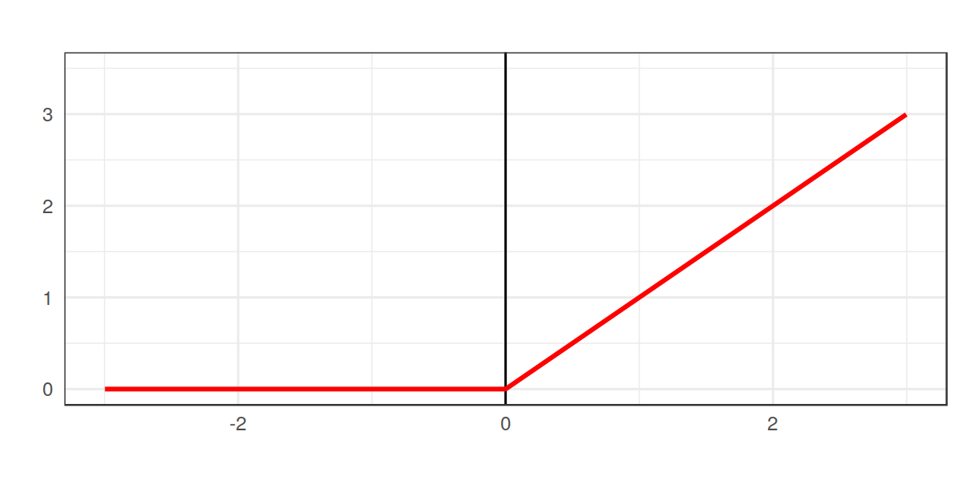
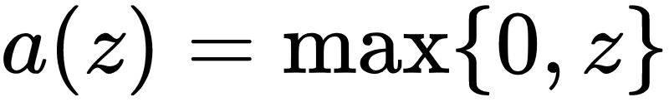
ReLU
The rectified linear unit (ReLU) is the most common activation for hidden layers.
It was inspired by neurobiology, since real neurons don’t activate until some stimulus threshold is met.
There are variants of the ReLU (see: Leaky ReLU).

Slide 27
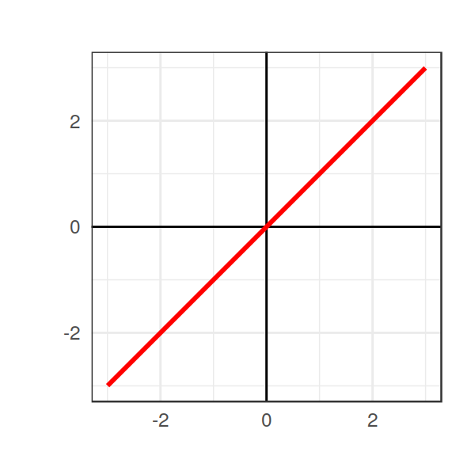
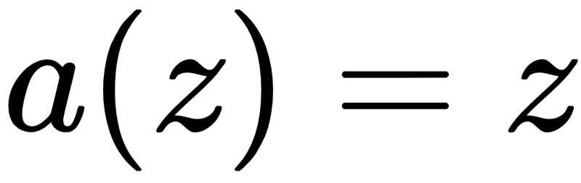
Identity/Linear
This activation does nothing. It is often used as the output for a regression problem, since it maps to the whole real line.
Never use the identity activation as a hidden layer activation!

Slide 28
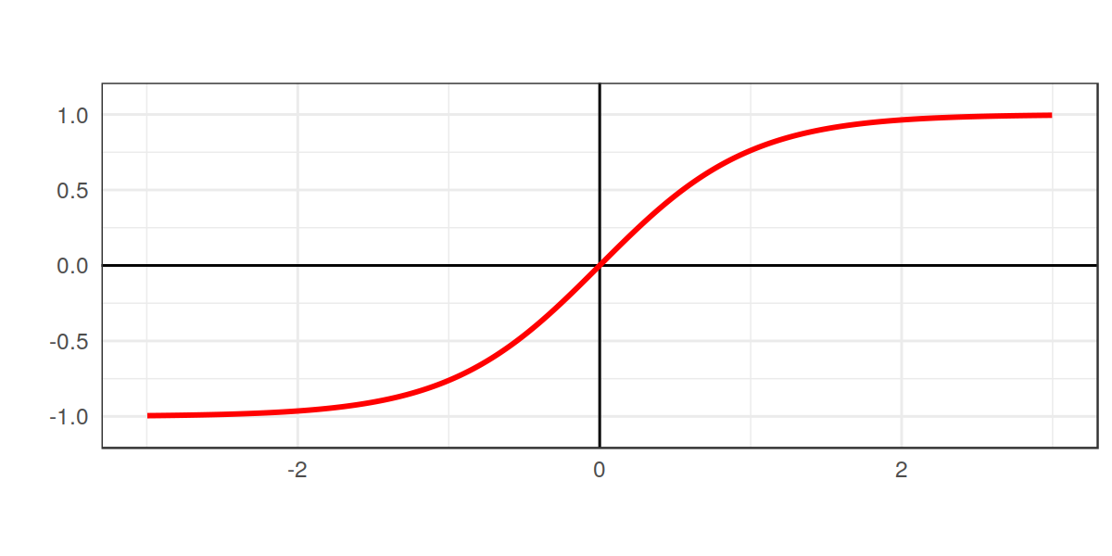
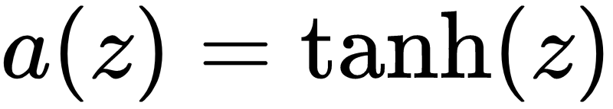
Hyperbolic Tangent
The tanh function is pronounced “tanch” and varies between -1 and 1.
It is sometimes used as a hidden layer activation, but usually doesn’t perform as well as ReLU.
It is sometimes used as output for binary classification, but doesn’t differ very much from sigmoid.

Slide 29
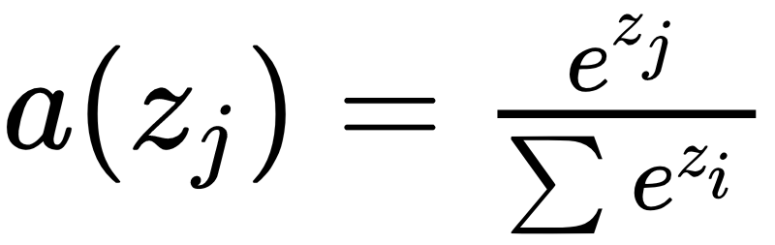
Softmax
The softmax is an extension of the sigmoid to multiclass classification. It is used as the output activation for multiclass classification.
It is vector valued, and varies between 0 and 1 for each element, and sums to 1. This means the softmax is like a vector of probabilities!

Slide 30
Logic Behind Hidden Layer Activations
Activations in the hidden layer provide a transformation that allow the neural net to learn more complex relationships as calculations propagate through the network.
There is little need to use different activations across different hidden layers.

Slide 31
Logic Behind Hidden Layer Activations
Sigmoid used to be the hidden activation of choice, but it has problems. Our optimization will be gradient-based, and the gradients are approximately zero for extreme values. This yields slow learning.
Once ReLU was discovered, the sigmoid was abandoned for hidden layers, and is now actively discouraged.
Gradients are too small here!

Slide 32
Output Layer Activations
The output layer activations are particularly important because those decide what form our predictions take.
Your output activation should map onto the space of values occupied by your target variable.
What that means is...

Slide 33
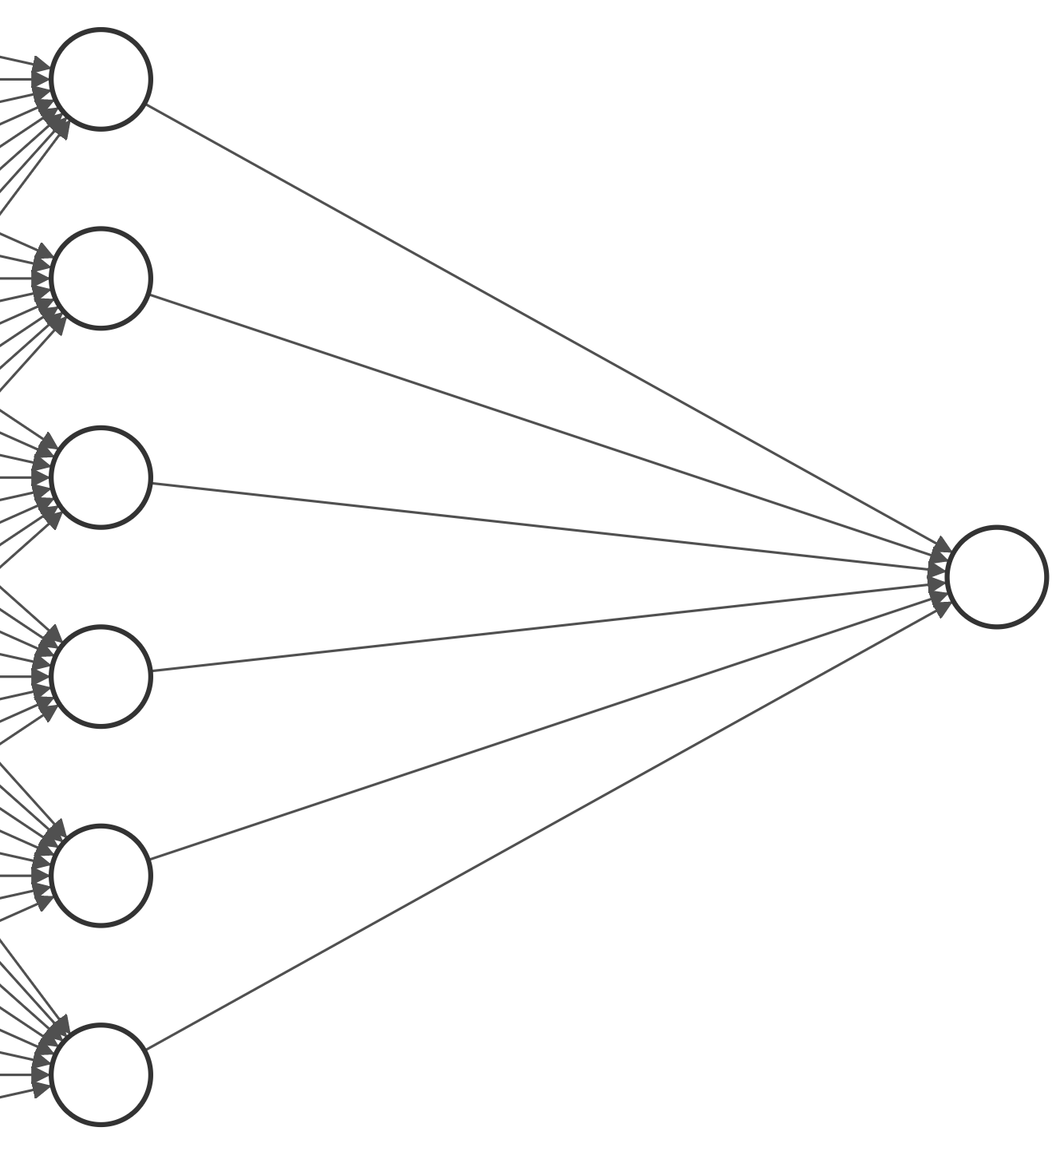
Output Activations: Binary Classification
If your output variable is a binary class, your best bet is the sigmoid activation, since it maps directly onto 0 and 1.
Allegedly, some people also use the tanh activation, which maps between -1 and 1, and simply scale it afterwards.
z = 2.8
σ(2.8) = 0.943

Slide 34
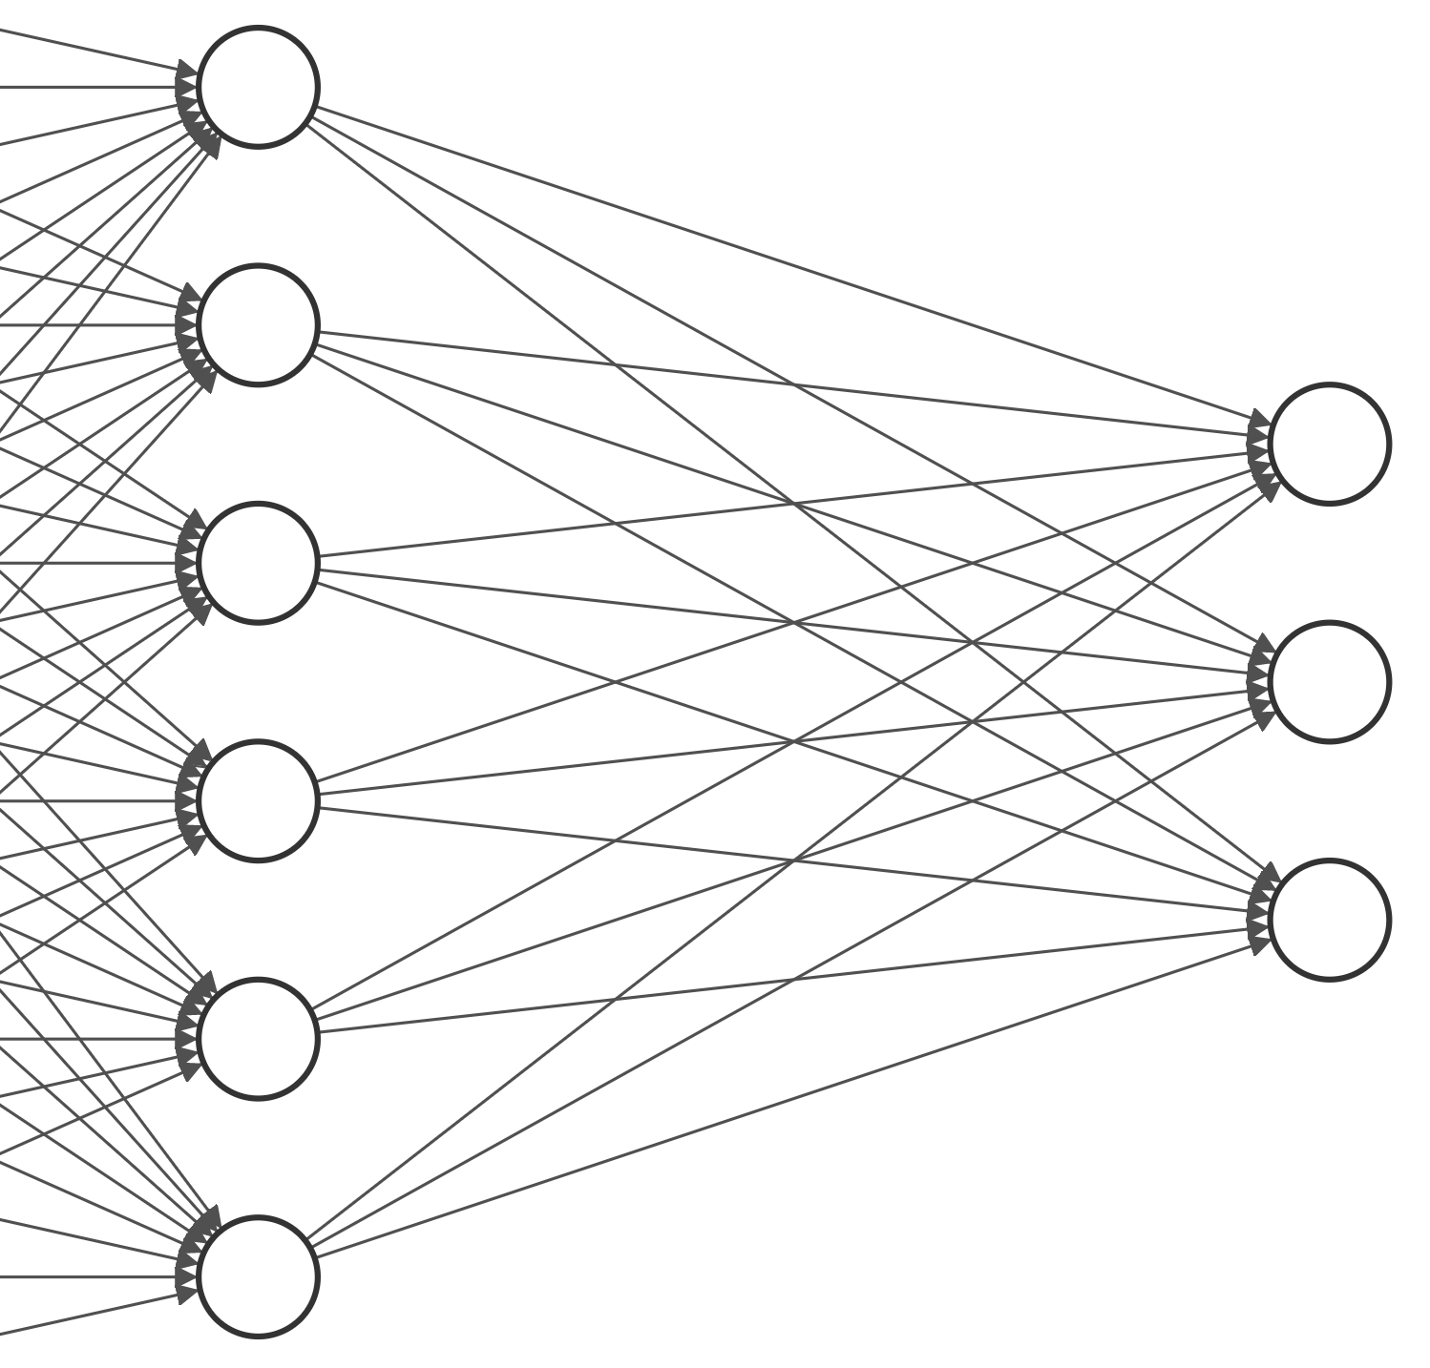
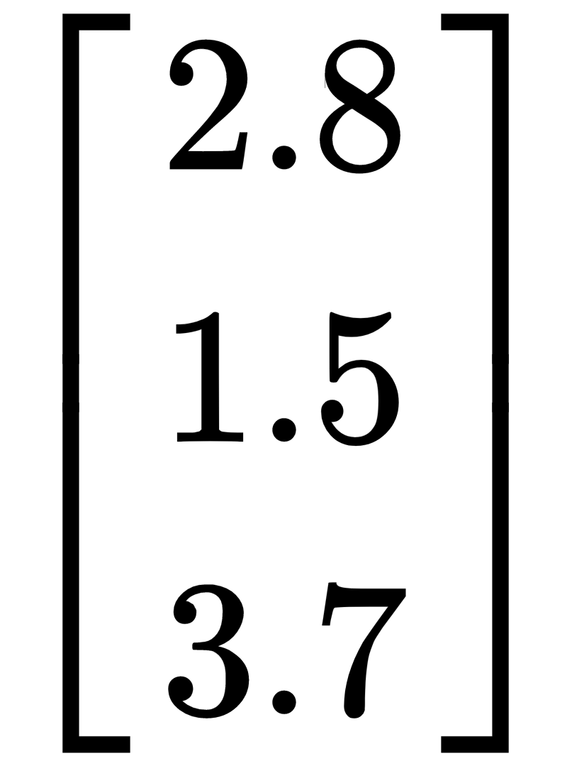
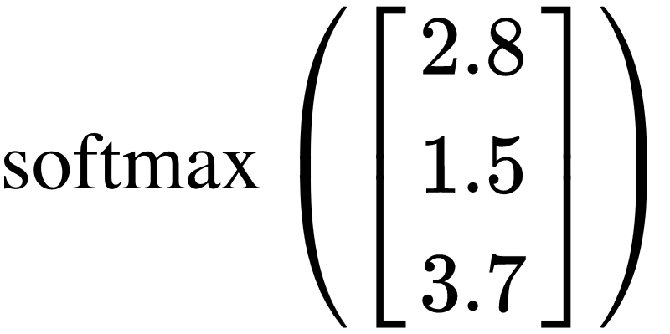
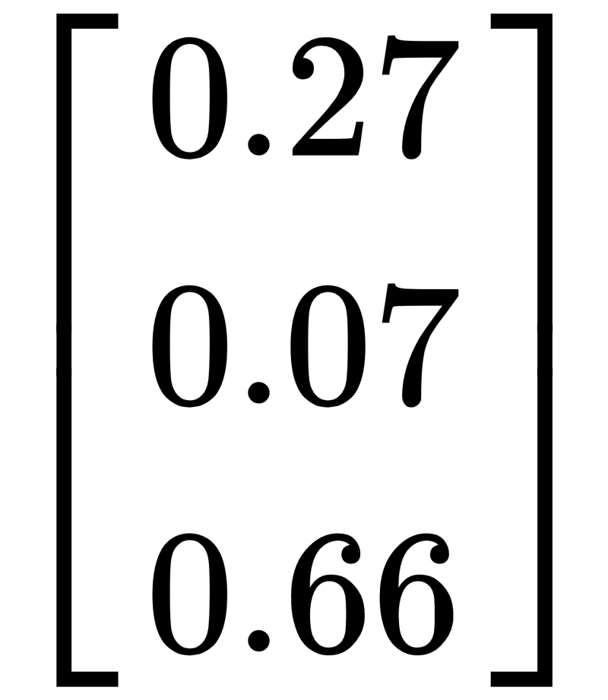
Output Activations: Multiclass Classification
For multiclass classification, the softmax activation generalizes the sigmoid to many outputs. Notice three nodes in the output layer!

Slide 35
Output Activations: Regression
When carrying out regression, there is no need to transform output, since you are predicting a quantity. You may either specify the linear/identity activation, or (in most software), you can simply decline to specify an activation.
But… you may be underwhelmed. Solving regression problems using deep learning tends to underperform other methods (trees, linear models, etc.).
One trick that’s becoming popular is to MinMaxScale your target variable and use a sigmoid activation in your output layer. Simply inverse transform your results to get predictions.

Slide 36
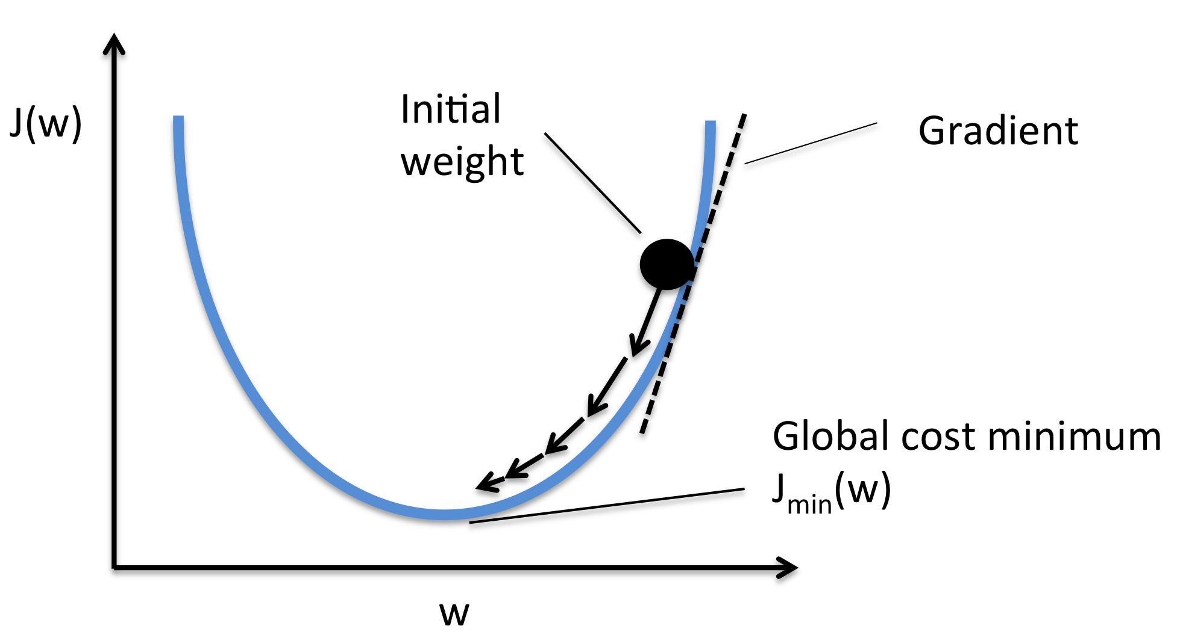
Loss Functions
Neural networks are fit using gradient descent with respect to some loss function that measures how wrong your results are. These don’t vary very much, and they probably look a little familiar:

Slide 37
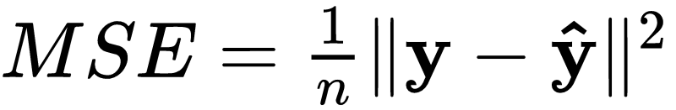
Loss Functions
For regression, we often pick:
For binary classification, we often pick binary crossentropy:
For multiclass classification, we have crossentropy, which is a generalization of binary crossentropy.

Slide 38
Back Propagation
The reason neural networks are so computationally intensive is because of the algorithm that is used to fit them: back propagation, or backprop for short. It involves iterating between two steps:
Forward pass - Compute predictions and loss
Backward pass - Compute gradients based on predictions and update weights.

Slide 39

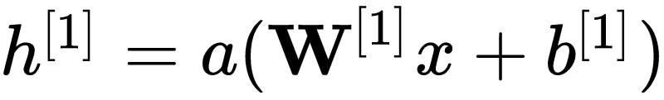
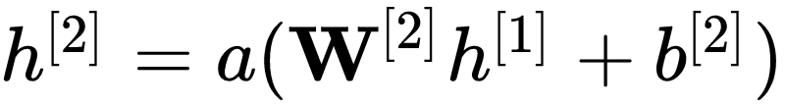
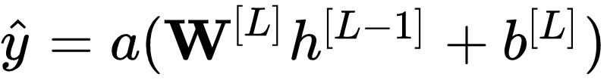
Forward Pass
...

Slide 40
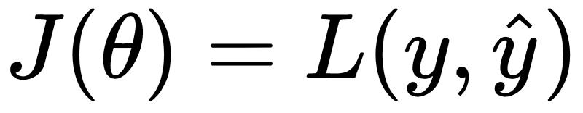
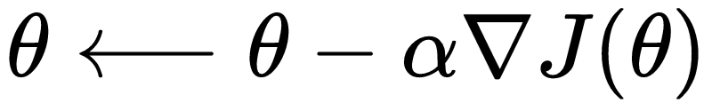
Backward Pass
Compute loss
Update weights (let θ denote all model parameters)
Learning rate

Slide 41
Slack Quiz: How many parameters need to be learned? (exclude bias/intercept term)

Slide 42

If you thought MCMC was slow...
Neural networks are notoriously slow to fit. Even medium sized networks can have over a million weights to train. How can we speed this up?
Get access to a better computer (preferably with a GPU)
Use minibatch techniques
Use fancier optimization techniques

Slide 43



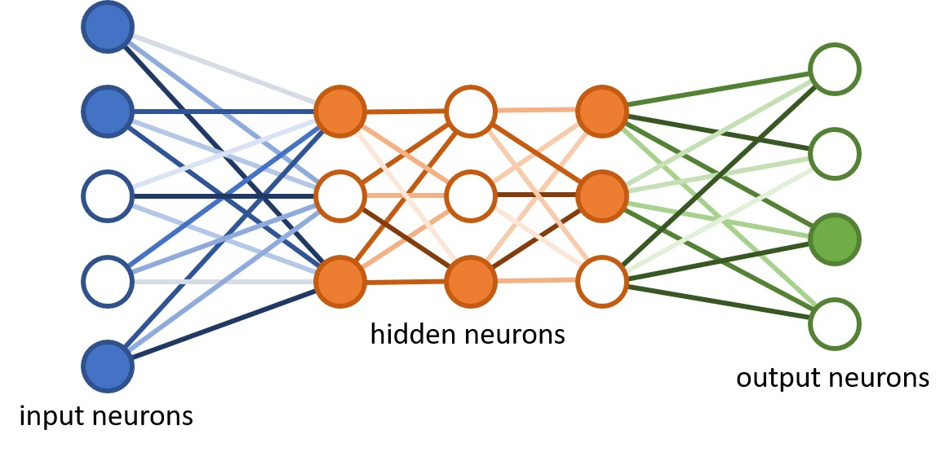
Bigger and Better: GPUs
GPUs are essentially matrix multiplication machines. Neural network training takes a fraction of the time when using one.
It is very unwise to have a production-level neural network not taking advantage of a GPU.
You can rent GPU time from every major cloud computing resource.

Slide 44
Minibatch Techniques
Actually, the biggest barrier to efficient training is the fact that we’re trying to use all of our data at once!
Instead, at each iteration of gradient descent, we’ll use a minibatch of the data. A minibatch will be a smaller subsampling of the full data. One run through the full dataset is called an epoch. This is pronounced “epic,” unless you are British or Matt Brems, in which case it is “eepock.”
For example, if you have 1,000 samples with a minibatch size of 100, you will run through 10 training steps in each epoch.

Slide 45
Minibatch Advantages
Even though we aren’t using the full data at once, this method is actually superior to using the full dataset. There are (at least) three reasons for this:
It’s much faster.
Allows us to do “online learning” (train some of the model now, train more when we get more data later).
Helps us avoid local minima during optimization, which can be a big concern.

Slide 46
Minibatch Size
The minibatch size is typically small. It is commonly as low as 16 or 32. An interesting note: minibatch sizes are typically a power of 2, since that works best with the inner workings of GPUs.
Stochastic gradient descent (SGD)
Minibatch
Batch
1
n

Slide 47
Fancy Optimization
A lot of academic research goes into faster and more efficient techniques for gradient descent. You don’t need to know how they work, but you’ll want to recognize their names:
AdaGrad (Adaptive Gradient)
RMSProp (Root Mean Square Propagation)
Adam (Adaptive Moment Estimation)
They each provide interesting updates to the usual gradient descent. You’ll see RMSProp and Adam the most.

Slide 48
Overfitting
Finally, we might be concerned with overfitting. There are lots of techniques for regularizing your neural net. We have a whole class devote to this:
Penalty parameters at each hidden layer
Dropout
Early stopping

Slide 49
Key Takeaways
On their surface, neural networks are easy to think about. Push data through a bunch of layers of nodes, at each layer transforming your input until you get a good prediction.
This process is very difficult to get working efficiently. Deep learning takes a great deal of patience to get up and running.
It’s gonna be a long week! But it’s worth it. Neural nets are awesome and they are the future.

Slide 50

Welcome to Neural Net Week!

